Slide 1
4.
Security design og principper for sikkert design

Slide 2
Sikker software, hvorfor?
Usikker software
GDPR
Etik
Ansvarlighed
‘Prevention is cheaper than the cure’
NotPetya omkostninger på $1.2B
Phase | Relative cost to correct
Definition | $1
High-level Design | $2
Low-level Design | $5
Code | $10
Unit test | $15
Integration test | $22
System test | $50
Post-delivery | $100

Slide 3
Hvordan bliver software usikkert?
Design fejl
Privelegier
Insecure defaults
Defence in depth
Implementations fejl
Input validering
Fejlhåndtering
Maintainence
Unpatched software
Legacy systemer
Højkvalitetssoftware = Bedre sikkerhed

Slide 4
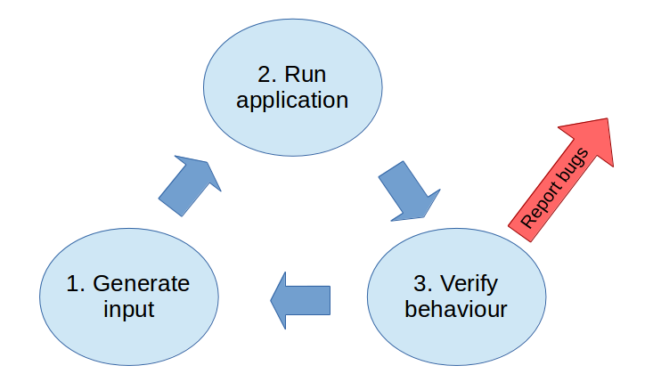
Hvad er fuzzing?
“Fuzzing or fuzz testing is an automated software testing technique that involves providing invalid, unexpected, or random data as inputs to a computer program. The program is then monitored for exceptions such as crashes, failing built-in code assertions, or potential memory leaks.” - Wikipedia
Simplificeret
Fejl kan lede til kompromitering

Slide 5
Simpelt eksempel
$ perl print ‘A’x100
Buffer overflows

Slide 6
Hvad kan man fuzze?
… Mange ting!
Inputs
Webforms
Logins
Programmer

Slide 7
Fuzzing tools
Scapy
American Fuzzy LOP
Sulley

